Slide 1
AG0800a Graphics Programming
Introduction to 3D graphics
Dr Paul Robertson
p.robertson@abertay.ac.uk

Slide 2
Overview
Module aim
To provide an introduction to 3D graphics programming
Learn skills and techniques associated with basic 3D graphics
By the end of the module you will
Be able to explain and understand the basic theoretical principles of 3D graphics Programming
Apply this knowledge to develop 3D applications for the PC using OpenGL
Increase your abilities as a C++ programmer

Slide 3
Overview
Module Topics
Intro to 3D Graphics
Transformation + Hierarchical modelling
Lighting
Texturing
Camera
Depth + transparency
Vertex arrays + procedural shape generation
Model loading
Stencil buffer
Shadows
Weekly Structure
Lecture
2 Hours of Lab Time
6 Hours of personal study

Slide 4
Assessment
Coursework
Create a 3D scene using OpenGL
Submission end of this semester
Digitally submit a working version of your application
Demonstration of application (not set in stone)
Lots of Freedom in this Coursework
The scene can be anything you want
For example a scene of your own construction, or replicate a scene from a favourite game or film

Slide 5
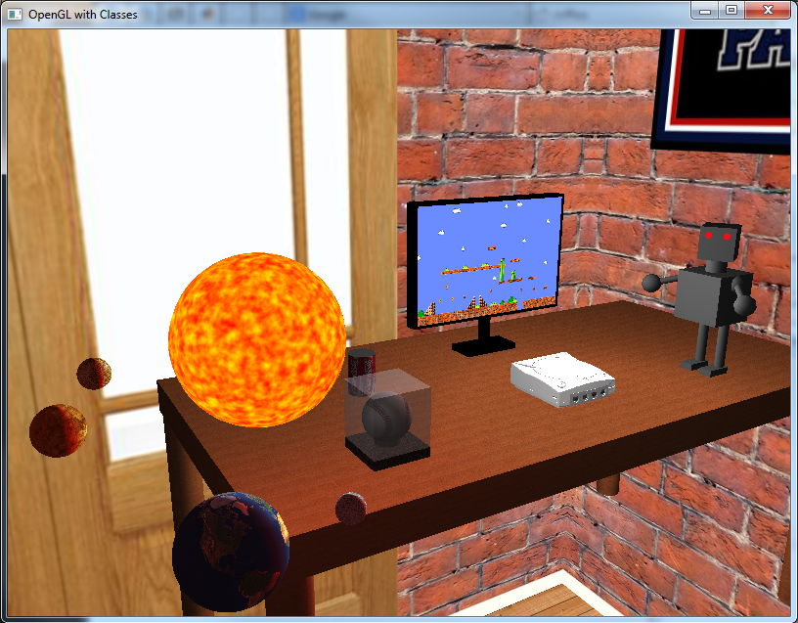
Previous coursework examples

Slide 6
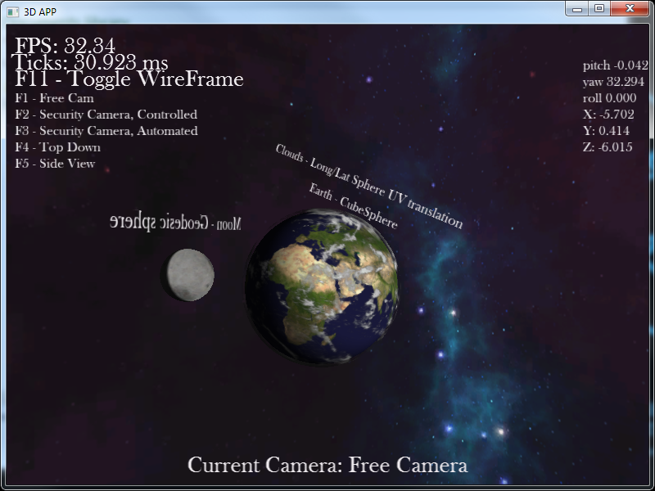
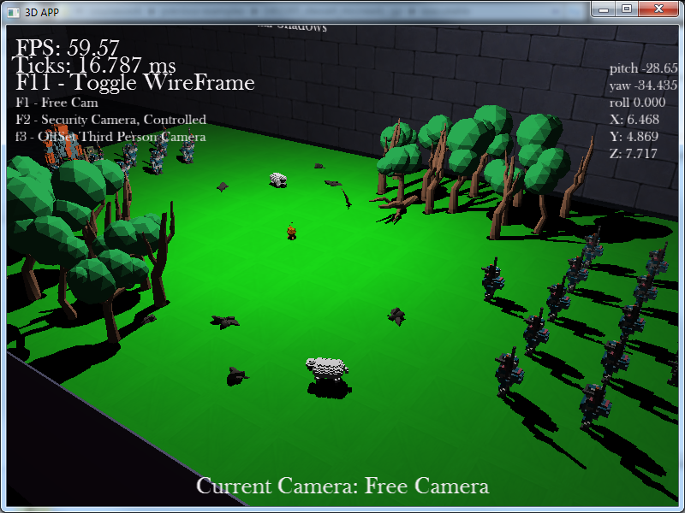

Slide 7
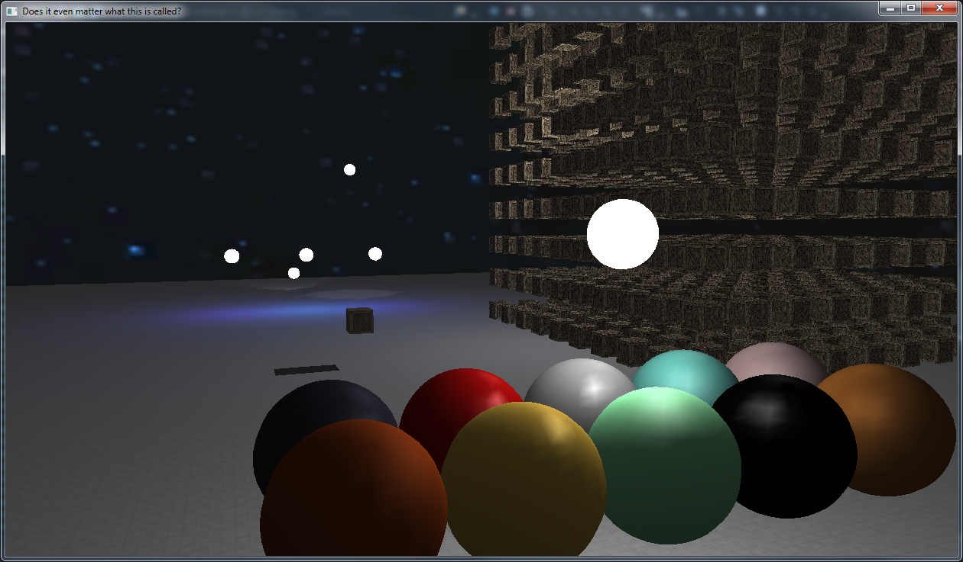
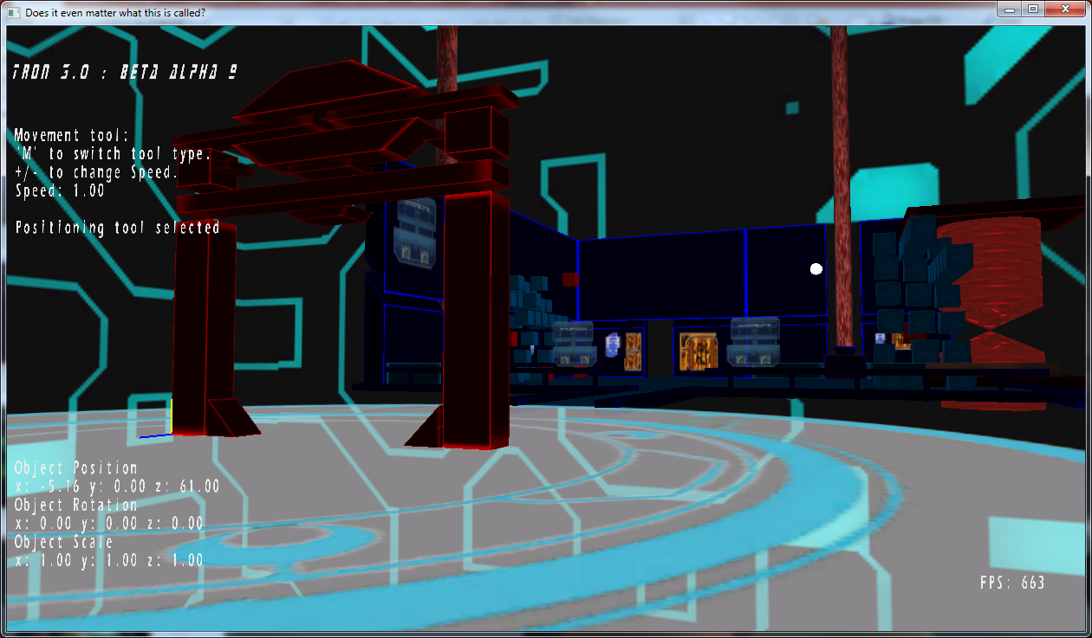
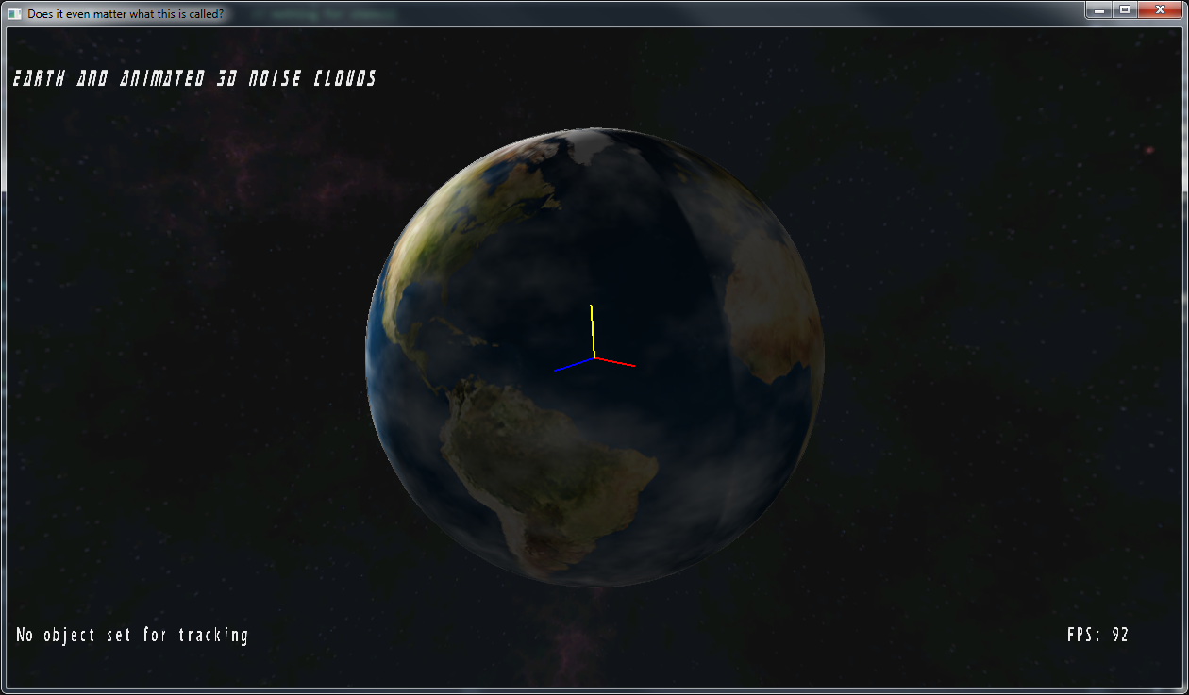

Slide 8
Lab sessions
One tutorial per lecture
In most cases each tutorial will have a few tasks
If you achieve the lab goal, you are effectively done
Try to let me see your work before you run away though
I encourage you to play around with what you have learned in the lab
Try different things, change values etc
Ask questions
Myself and a lab assistant will provide help in the lab sessions
?

Slide 9
Lab sessions
During the labs
Our lovely lab area is precious so don’t mistreat it
No food or drink etc
When something breaks/doesn’t work
Report it!
Either tell me or tech support
It will get fixed (quickly)
No facebook / twitter / pokemon go

Slide 10
Questions outside of lab
Most questions should be ask during labs
If you wish to discuss the module outside of the lab send an email or meeting request

Slide 11
AG0800a Graphics Programming
3D Introduction

Slide 12
Graphics API’s
What is an API? (Application programming interface)
Computer graphics tends to be handled by dedicated hardware
An API offers a layer of abstraction from the hardware for the programmer
Provide a toolset of functions that enable the creation and manipulation of graphics objects
API’s also are a balanced trade-off. Abstraction Vs functionality
API’s also, most importantly provide a STANDARD

Slide 13
Graphics API
Two major graphics APIs
OpenGL
Available on most platforms
Windows, Linux, Mac
Mobile platforms
Embedded systems
Consoles
Interwebs
http://www.opengl.org/
Latest version renamed to Vulkan

Slide 14
Graphics API
Direct X
Available only on a few systems
Windows and Xbox 360 / Xbone
Developed by Microsoft
http://www.microsoft.com/games/en-gb/aboutGFW/pages/directx.aspx
Others worth noting
PSGL
PlayStation 3’s modified OpenGL API
PS4 uses GNMX, proprietary graphics API

Slide 15
Graphics API
We will be using OpenGL – Why?
Easy to set-up
Easy to learn and use
Knowledge gained still relevant to other graphics API’s
Still capable of producing great visuals

Slide 16
The Graphics Pipeline
What is a Graphics Pipeline?
A sequence of steps applied to geometry or anything else that requires to be rendered
The output of the pipeline is a frame in the frame buffer
Represents a standard that developers and hardware manufacturers can adhere to

Slide 17
Graphics Pipeline
In Graphics programming there are two pipelines that are accepted as industry standard techniques
The Fixed Function Pipeline
The Programmable Pipeline

Slide 18
Fixed Function Pipeline
Concept
Series of steps established at API or hardware design
The programmer has a limited control over the process other than the setting of various modes and inputting data
Can produce very good looking results but is largely outmoded in modern games technology by the programmable pipeline

Slide 19
Programmable Pipeline
Concept
Various stages of the graphics pipeline are run on specially constructed hardware.
Custom programs can be run at separate stages of the pipeline to alter the rendering process.
These programs are known as “shaders”
Shaders can affect geometry information – Vertex Shaders
Shaders can affect information on a single pixel in the frame buffer – Fragment Shaders
Modern graphics hardware is designed entirely with the programmable pipeline in mind

Slide 20
OpenGL Pipeline
How does OpenGL work on modern graphics hardware?
The fixed function pipeline is EMULATED
We ARE using the vertex processor
We ARE using the Fragment processor
The only difference is we cannot ‘program’ the pipeline, although we use the same technology as the programmable pipeline

Slide 21
OpenGL Pipeline
Pipeline Stages (In order)
Modelling
Lighting & Shading
Viewing
Clipping
Projection
Rasterisation

Slide 22
OpenGL Pipeline
Modelling
The creation / describing of 3D objects within our game world
Lighting and shading
The surface properties of the objects are calculated based on the virtual lights in our scene
Viewing
Objects are transformed from their own local coordinate systems to the coordinate system of the camera

Slide 23
OpenGL Pipeline
Clipping
Includes removing objects (or part of objects) that are not within the view volume
Projection
Projecting the objects in our scene onto a 2-dimensional plane. Using a perspective transformation to obtain a 3D effect
Rasterisation
The finished scene is then converted into a 2D image which is placed in the frame buffer

Slide 24
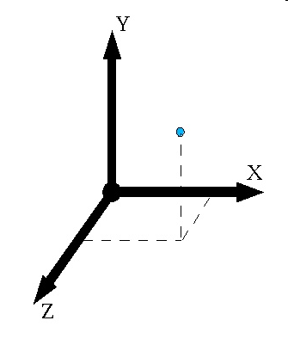
3D Geometry
Our game world is described by 3D geometry
Right handed 3D coordinate system

Slide 25
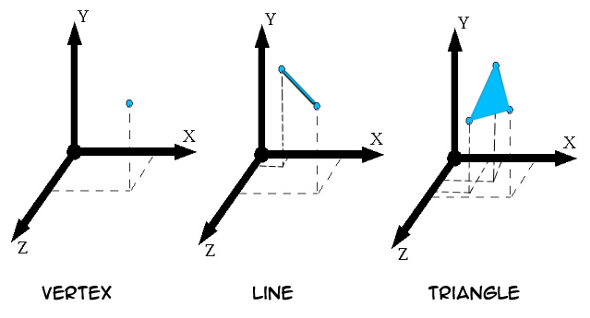
3D Geometry
All 3D objects are defined by geometric primitives, which OpenGL allows us to define

Slide 26
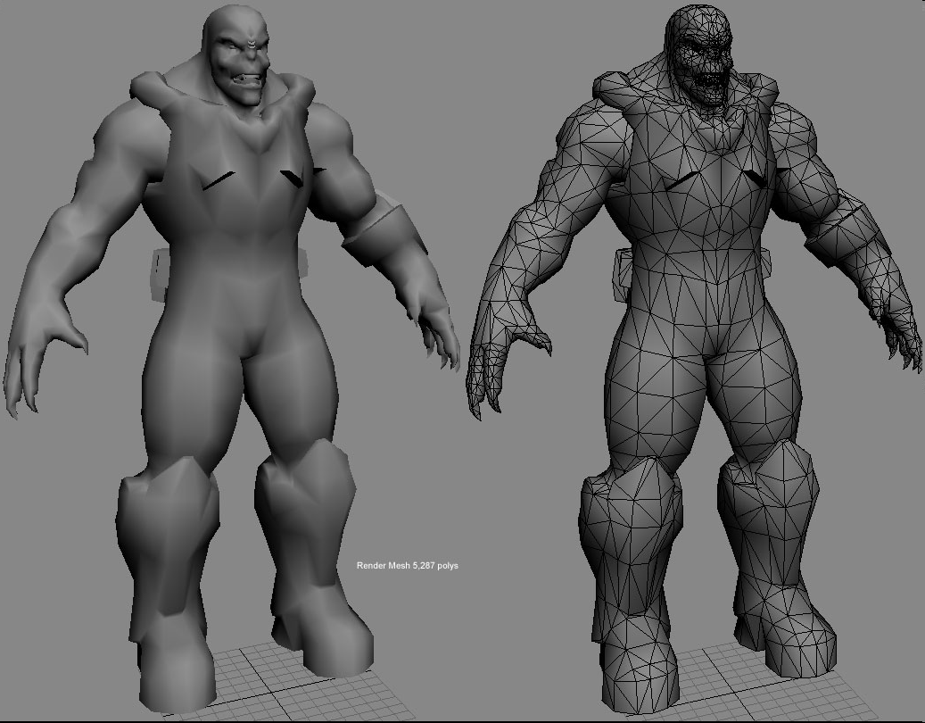
3D Geometry
Using these, we can create anything.

Slide 27
OpenGL Syntax
Command Syntax
Like any API, OpenGL has its own unique syntax that we have to learn in order to use it
Functions
Prefix: gl
Capital letters for first letter of each word making up the command name.
Eg: glClearColor();

Slide 28
Command Syntax
Constants
Prefix: GL_
All capital letters
Words separated with _
Eg GL_COLOR_BUFFER_BIT

Slide 29
Command syntax
Command name Suffix
Some OpenGL function can be seen to have different suffix
Eg glVertex2f(), glColor3f()
Number indicates the number of arguments for the function
Letter indicates the data type
F corresponds to a float value.

Slide 30
Command Syntax
Data types
OpenGL has its own set of data types that can be used
GLbyte b 8-bit integer
GLfloat f 32-bit float
GLushort us unsigned short
etc

Slide 31
OpenGL as a State Machine
OpenGL IS a state machine
We control the setting of states and they remain in effect until we alter them
eg the current colour is set by
glColor3f(1.0, 1.0, 0.0);
All objects will be drawn in this colour unless we change it
We can change it at any point

Slide 32
OpenGL as a State Machine
States we can set:
Current viewing and projection transforms
Polygon Drawing modes
Positions and characteristics of lights
Material properties
Many states refer to modes that are turned off and on with
glEnable(state);
glDisable(state);

Slide 33
Framework
Pre-made project for starting
Cross platform (mostly)
Does the basics
You will be expanding on it
Uses GLUT
openGL Utility Toolkit
Provides the Window
Registers input events
Uses OpenGL (slightly older version)
Follows Google C++ commenting style guide
https://google.github.io/styleguide/cppguide.html

Slide 34
Framework
Classes
Main
Entry point, creates Window, callback for input events, initialises scene
Input
Stores keyboard and mouse events/data
Scene
Encompasses 3D scene
Most of our work will be done in here (for the first few weeks)
Vector3
Class representing a 3D vector

Slide 35
Project setup
Project links to a couple of important libraries
Project settings >> Linker >> Input
OpenGL32.lib
Glu32.lib
Include in code
#include <gl/gl.h>
#include <gl/glu.h>

Slide 36
Code
Some code to follow, check the framework provided for full code
Some important stages handled by the framework
Drawing our first 3D shape

Slide 37
Scene constructor()
Scene::Scene(Input *in)
{
// Store pointer for input class
input = in;
//OpenGL settings
glShadeModel(GL_SMOOTH);// Enable Smooth Shading
glClearColor(0.39f, 0.58f, 93.0f, 1.0f);// Cornflour Blue Background
glClearDepth(1.0f);// Depth Buffer Setup
glEnable(GL_DEPTH_TEST);// Enables Depth Testing
glDepthFunc(GL_LEQUAL);// The Type Of Depth Testing To Do
glHint(GL_PERSPECTIVE_CORRECTION_HINT, GL_NICEST);// Really Nice Perspective Calculations
// Other OpenGL / render setting should be applied here.
// Initialise variables
}

Slide 38
Scene update()
void Scene::update(float dt)
{
// Handle user input
// Update object and variables (camera, rotation, etc).
// Calculate FPS
frame++;
time = glutGet(GLUT_ELAPSED_TIME);
if (time - timebase > 1000) {
sprintf_s(fps, "FPS: %4.2f", frame*1000.0 / (time - timebase));
timebase = time;
frame = 0;
}
}

Slide 39
Scene render()
void Scene::render() {
// Clear Colour and Depth Buffers
glClear(GL_COLOR_BUFFER_BIT | GL_DEPTH_BUFFER_BIT);
// Reset transformations
glLoadIdentity();
// Set the camera
gluLookAt(0.0f, 0.0f, 6.0f, 0.0f, 0.0f, 0.0f, 0.0f, 1.0f, 0.0f);
// Render triangle
glBegin(GL_TRIANGLES);
glVertex3f(0.0f, 1.0f, 0.0f);
glVertex3f(-1.0f, -1.0f, 0.0);
glVertex3f(1.0f, -1.0f, 0.0);
glEnd();
// Render text, should be last object rendered.
renderTextOutput();
// Swap buffers, after all objects are rendered.
glutSwapBuffers();
}

Slide 40
Scene resize()
void Scene::resize(int w, int h)
{
width = w;
height = h;
// Prevent a divide by zero, when window is too short
// (you cant make a window of zero width).
if (h == 0)
h = 1;
float ratio = (float)w / (float)h;
fov = 45.0f;
nearPlane = 0.1f;
farPlane = 100.0f;
// Use the Projection Matrix
glMatrixMode(GL_PROJECTION);
// Reset Matrix
glLoadIdentity();
// Set the viewport to be the entire window
glViewport(0, 0, w, h);
// Set the correct perspective.
gluPerspective(fov, ratio, nearPlane, farPlane);
// Get Back to the Modelview
glMatrixMode(GL_MODELVIEW);
}

Slide 41
Scene render text output()
void Scene::renderTextOutput()
{
// Render current mouse position and frames per second.
sprintf_s(mouseText, "Mouse: %i, %i", input->getMouseX(), input->getMouseY());
displayText(-1.f, 0.96f, 1.f, 0.f, 0.f, mouseText);
displayText(-1.f, 0.90f, 1.f, 0.f, 0.f, fps);
}

Slide 42
Scene display text
void Scene::displayText(float x, float y, float r, float g, float b, char* string) {
// Get Lenth of string
int j = strlen(string);
// Swap to 2D rendering
glMatrixMode(GL_PROJECTION);
glLoadIdentity();
glOrtho(-1.0, 1.0, -1.0, 1.0, 5, 100);
glMatrixMode(GL_MODELVIEW);
glLoadIdentity();
// Orthographic lookAt (along the z-axis).
gluLookAt(0.0f, 0.0f, 10.0f, 0.0f, 0.0f, 0.0f, 0.0f, 1.0f, 0.0f);
// Set text colour and position.
glColor3f(r, g, b);
glRasterPos2f(x, y);
// Render text.
for (int i = 0; i < j; i++) {
glutBitmapCharacter(GLUT_BITMAP_HELVETICA_12, string[i]);
}
// Reset colour to white.
glColor3f(1.f, 1.f, 1.f);
// Swap back to 3D rendering.
glMatrixMode(GL_PROJECTION);
glLoadIdentity();
gluPerspective(fov, ((float)width/(float)height), nearPlane, farPlane);
glMatrixMode(GL_MODELVIEW);
}

Slide 43
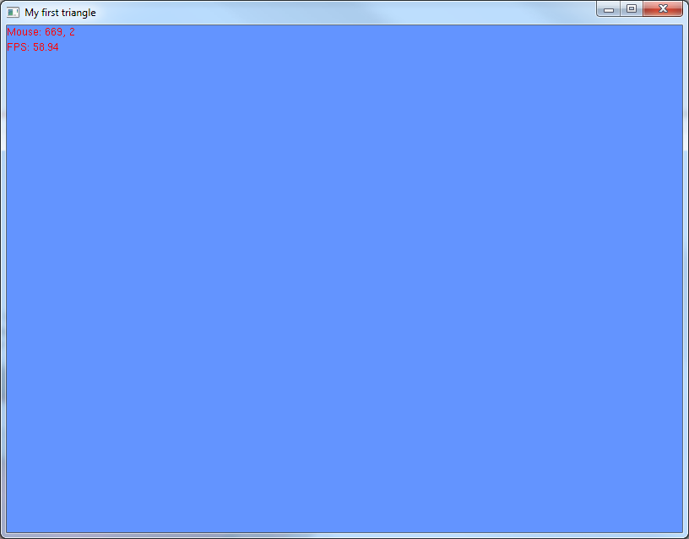
Our 3D world

Slide 44
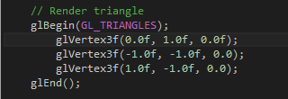
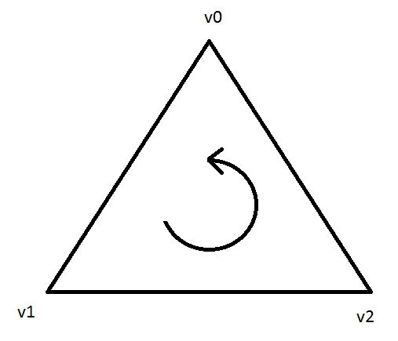
Drawing geometry
Specify primitive being drawn
List vertices for shape
Must be in anti-clockwise order

Slide 45
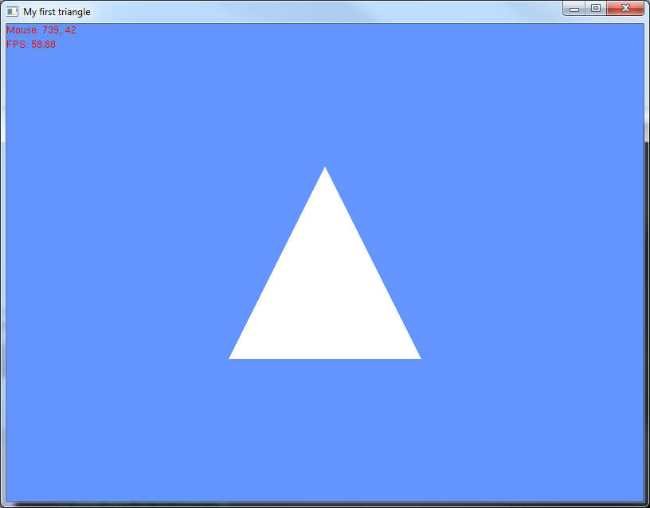
Results

Slide 46
Adding colour
// Set colour to red
glColor3f(1.0f, 0.0f, 0.0f);
// Render triangle
glBegin (GL_TRIANGLES);
glVertex3f(0.0, 1.0, 0.0);
glVertex3f(-1.0, 0.0, 0.0);
glVertex3f( 1.0, 0.0, 0.0);
glEnd();

Slide 47
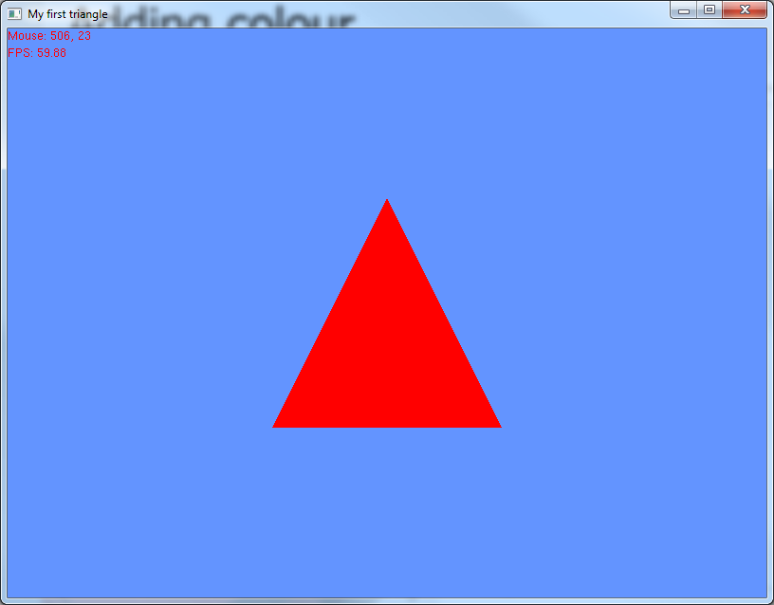
Colour

Slide 48
Adding colour
glBegin (GL_TRIANGLES);
glColor3f(1.0f, 0.0f, 0.0f);
glVertex3f(0.0, 1.0, 0.0);
glColor3f(0.0f, 1.0f, 0.0f);
glVertex3f(-1.0, 0.0, 0.0);
glColor3f(0.0f, 0.0f, 1.0f);
glVertex3f( 1.0, 0.0, 0.0);
glEnd();

Slide 49
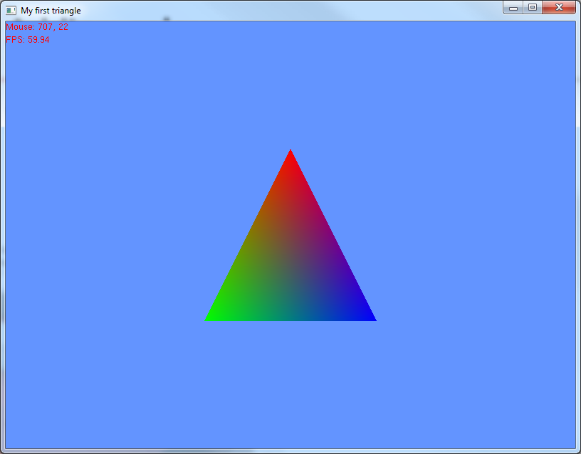
More colour

Slide 50
Other Drawing Primitives
GL_LINE_STRIP
GL_LINE_LOOP
GL_TRIANGLE_STRIP
GL_TRIANGLE_FAN
GL_QUADS
GL_POLYGON

Slide 51
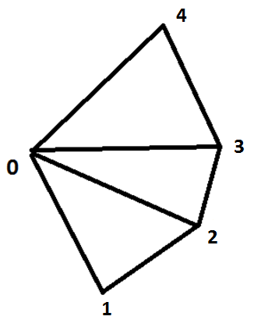
GL_TRIANGLE_FAN
First vertex is always held fixed
Every group of 2 vertices forms a triangle (including the first vertex)

Slide 52
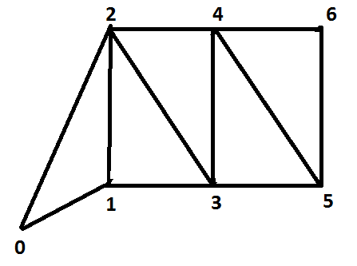
GL_TRIANGLE_STRIP
Adjacent groups of 3 vertices form a triangle
The face direction is determined by the winding of the first triangle

Slide 53
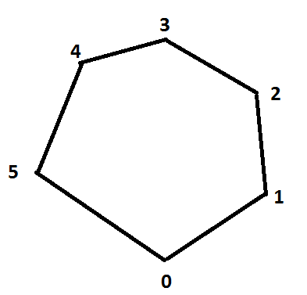
GL_POLYGON
Draws a single convex polygon
In reality OpenGL turns this into a collection of triangles for you
Be careful when defining your shape

Slide 54
Wireframe
We can control how objects are drawn
This comes in handy when debugging our scene
To turn on wireframe
glPolygonMode(GL_FRONT, GL_LINE);
This makes the front face wireframe
Not the back face
glPolygonMode(GL_FRONT, GL_FILL);
This turns on normal filled rendering

Slide 55
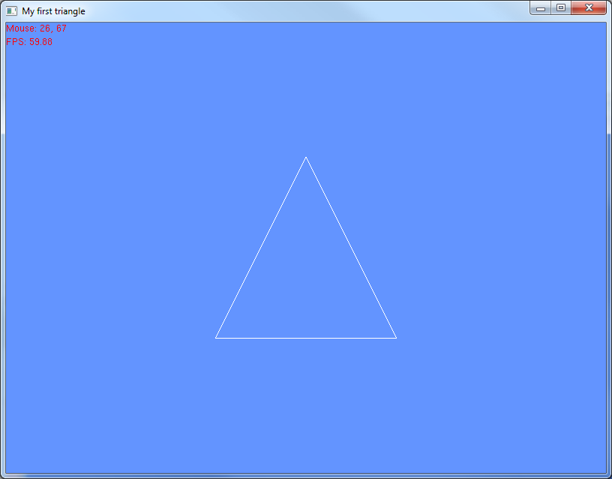
Wireframe

Slide 56
User input
Best practice is to handle user input in the update function()
Input class contains a bunch of getters and setters that toggle Booleans that represent keys and mouse buttons
Main detects key presses and stores them in the input class
// Getters and setters for keys
void SetKeyDown(unsigned char key);
void SetKeyUp(unsigned char key);
bool isKeyDown(int);

Slide 57
User input
An array stores Booleans for each key on the keyboard
When a key pressed is detect the Boolean is flipped to true
When a key is released the Boolean is flipped to false
In the scene class we can check if the Boolean is true/false, if a key is pressed or not
bool keys[256];

Slide 58
Mouse input
Struct to represent mouse
Stores position and button presses
Accompanied by getters/setters for access
struct Mouse
{
int x,y;
bool left, right;
};
void setMouseX(int);
void setMouseY(int);
void setMousePos(int x, int y);
int getMouseX();
int getMouseY();
void setLeftMouseButton(bool b);
bool isLeftMouseButtonPressed();

Slide 59
User input
Example
When v is pressed output message box
This could do anything: increment some value, set Boolean/variable, change opengl state, etc
// Handle user input
if (input->isKeyDown('v'))
{
MessageBox(NULL, "Key pressed", "Alert", MB_OK);
input->SetKeyUp('v');
}

Slide 60
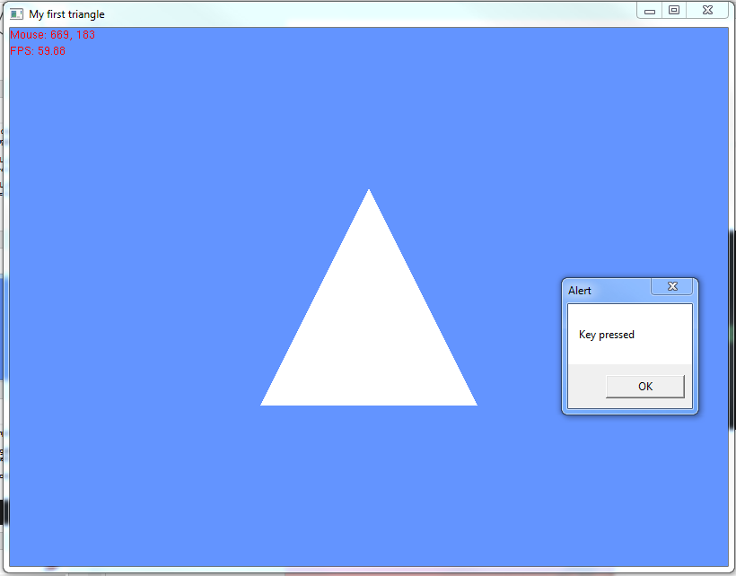

Slide 61
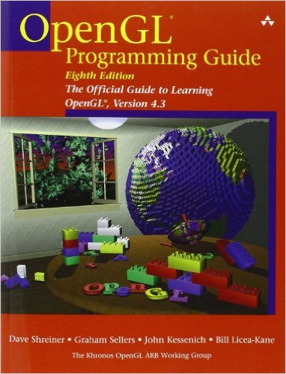
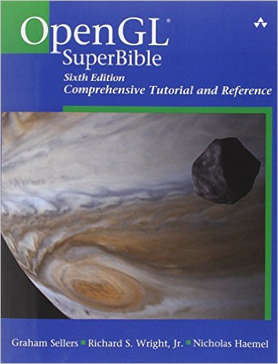
Resources
Books
OpenGL Programming Guide; Woo, Neider et-al
http://www.glprogramming.com/red/
OpenGL SuperBible; Wright et al.
Real-Time Rendering; Tomis Moller and Eric Haines
Web
Nehe.gamedev.net – Legacy OpenGL Tutorials

Slide 62
Reference material
Book
Programming Windows 5th Edition – Charles Petzold
Good source of extra tutorials and reference.
Only for the curious.
C++ Primer by Lippman
Web
msdn.microsoft.com
Your first port of call when you don’t know what something does
Checking MSDN will solve a lot of your problems.
C plus plus
http://www.cplusplus.com/

Slide 63
In the labs
Setting up and looking at the provided framework
Working with triangles
Rendering other primitive shapes
As a reminder, lab times
Thursday 11-1 3516 CGAD
Thursday 2-4 3516 CGT

Slide 65
What is AGDS?
Weekly Meetings
Make games together
Talks from Industry Professionals & Senior Students
Group transport & accommodation for Game Jams
Relax at the Pub and talk about video games

Slide 66
Why Join?
Make new friends
Get valuable insight into the industry
Get experience making video games
Expand your portfolio
Have fun!

Slide 67
What’s the cost?
£1 entry fee (earns you a badge)
A few hours a week
Option to buy GDS Hoodies

Slide 68
Where?
Mixer Event 8th September in Bar One at 7
Weekly Meetings on Thursdays, at 6
Location to be confirmed, join our group on Facebook to stay updated

Slide 69
How can you get involved?
Come to the Mixer (September 8th)
Join the Facebook group (facebook.com/groups/AbertayGDS/)
Like our Facebook page (facebook.com/gamesdevsociety/)
Follow us on Twitter @AbertayGDS
Email James Clayton at 1501082@uad.ac.uk

